Slide 1
Part 2: The Physical Layer

Slide 2
Summary
Transmission medium
* Switching
The Nyquist limit
The Shannon limit

Slide 3
(1) Transmission Medium
Guided Transmission Medium
Magnetic Media
Twisted Pair
Coaxial Cable
Fiber Optics
Unguided Transmission Medium (wireless transmission)
Radio
Infrared
Ultrasound
…
Notes:
Research on DTN, Localization

Slide 4
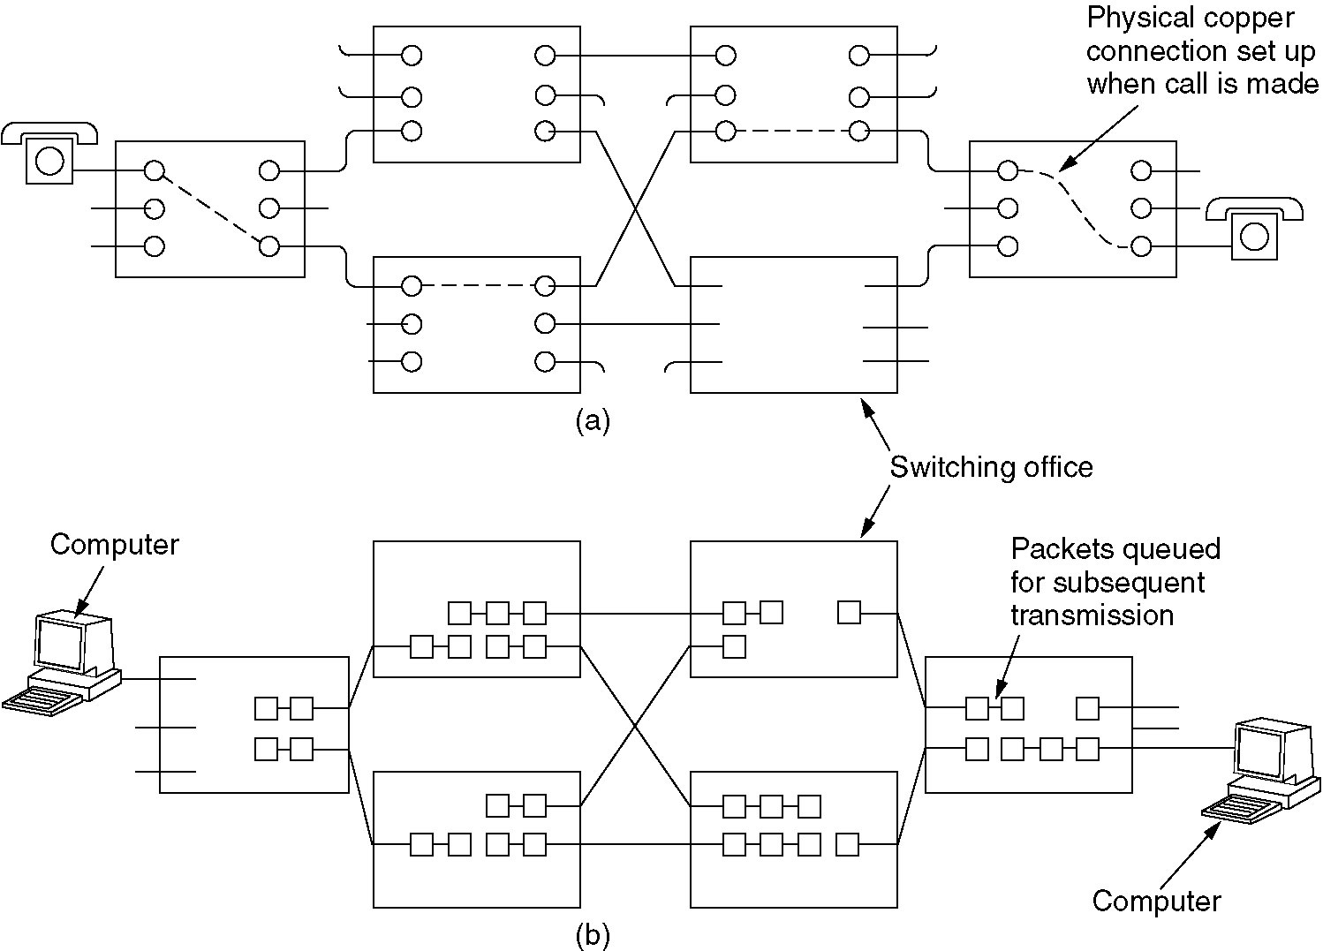
(2.1) Circuit Switching
(a) Circuit switching.
(b) Packet switching.

Slide 5
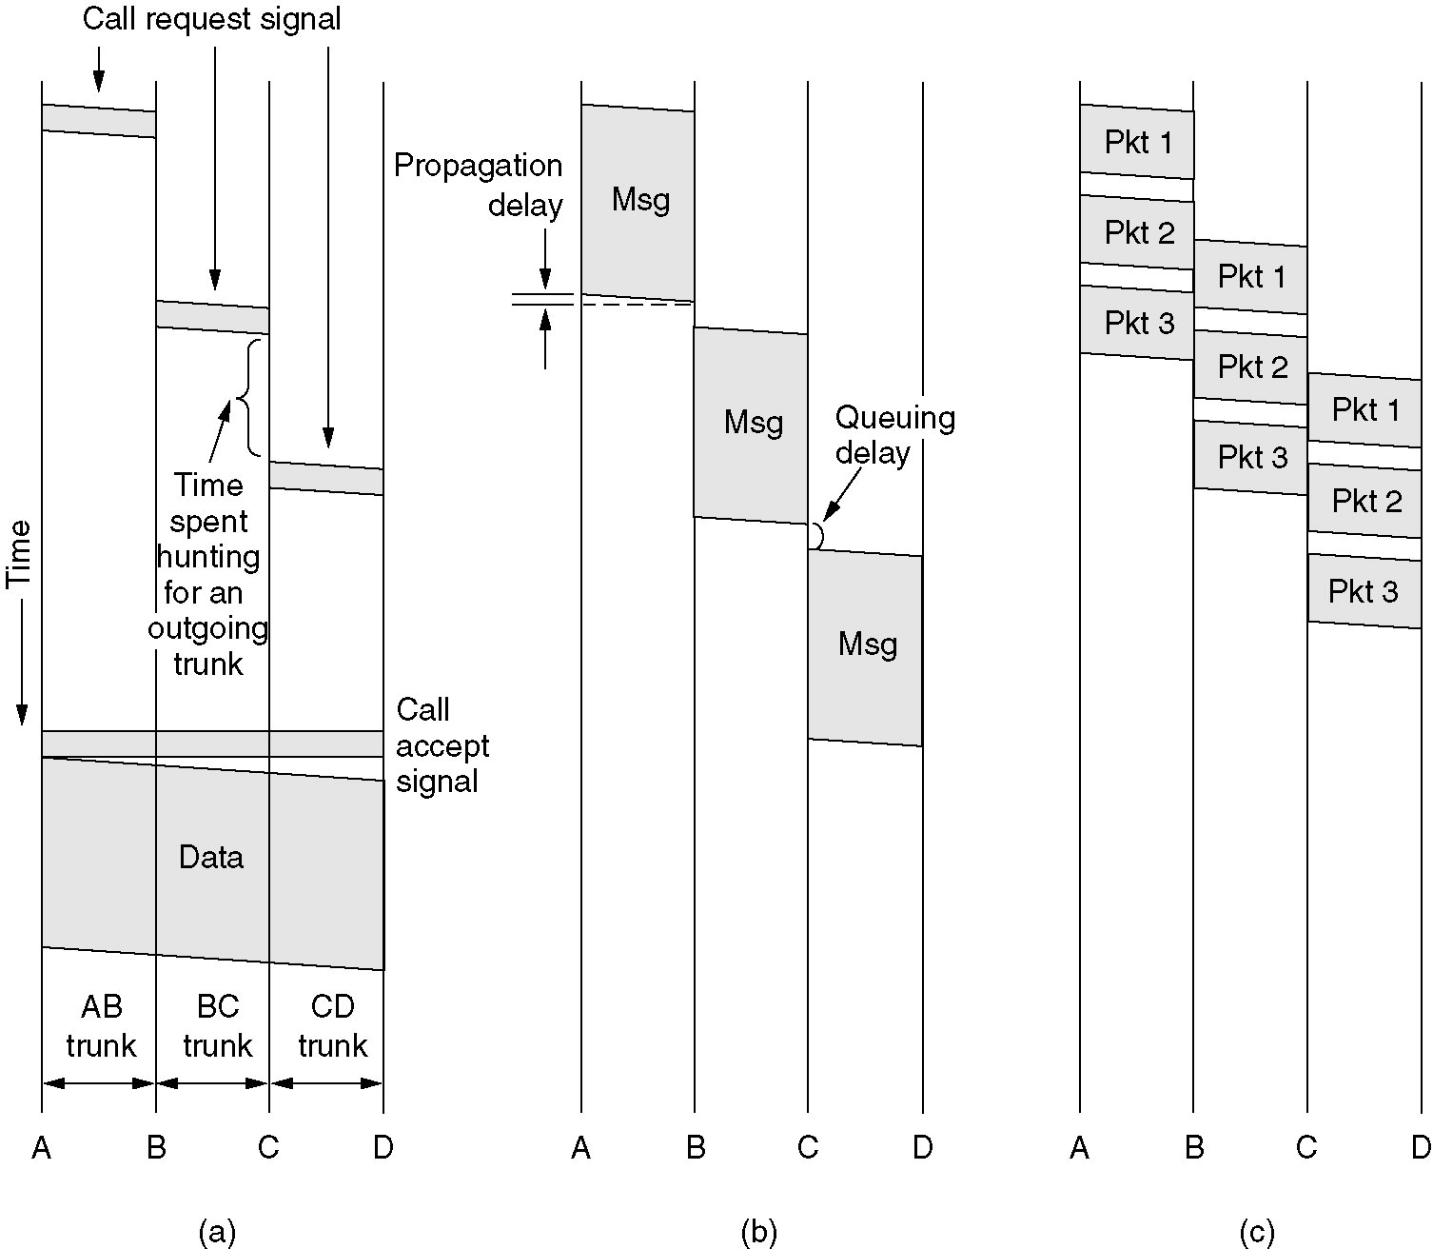
(2.2) Message Switching
(a) Circuit switching (b) Message switching (c) Packet switching
Notes:
An exercise

Slide 6
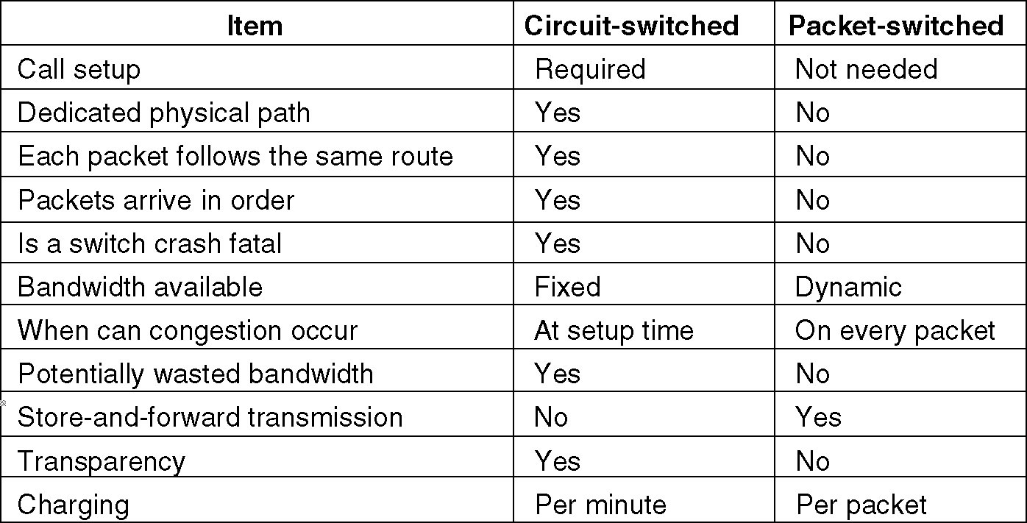
(2.3) A Comparison
A comparison of circuit switched and packet-switched networks.

Slide 7
(3) The Nyquist Limit
For a noiseless channel, the maximum data rate is:
2H log₂ V bits/sec
,where H is the channel bandwidth (in Hz) and V is the number of discrete levels of the signal.
Notes:
Several Examples

Slide 8
(4) The Shannon Limit
The maximum data rate of a noisy channel whose bandwidth is H Hz, and whose signal-to-noise ratio is S/N, is given by
H log₂ (1+S/N).
Notes:
Give an example.

